Slide 1


Fake News Detection Using Random forest Classifier
Submitted by: Thomas Basyal, Rajan Chaudhary
Subject: NLP
Semester: seven(Fall)

Slide 2
Abstract
Fake news detection using a random forest classifier is a machine learning approach that involves training a model on a dataset of real and fake news articles. The model then uses this training data to predict the authenticity of new articles.
Random forest classifiers are known for their accuracy and robustness, which makes them a popular choice for classification tasks. Additionally, they are able to handle high-dimensional datasets, which is often the case with text-based data such as news articles.
To use a random forest classifier for fake news detection, a dataset of news articles is first collected and labeled as either real or fake. This labeled dataset is then split into a training set and a test set. The training set is used to train the random forest classifier, which involves creating multiple decision trees based on different subsets of the data. These decision trees are then combined to make a final prediction about the authenticity of a news article. Once the model has been trained, it is tested on the test set to evaluate its accuracy. If the accuracy is high enough, the model can be used to predict the authenticity of new news articles. This involves preprocessing the text data, extracting relevant features, and using the trained model to classify the article as either real or fake.

Slide 3
Introduction
Fake news has become a widespread problem in recent years, with the potential to mislead and harm individuals and society as a whole. The rise of social media and the internet has made it easier than ever to spread false information, making it challenging to distinguish between what is true and what is not. Therefore, the development of fake news classifiers has become increasingly important to combat this issue.
A fake news classifier is a machine learning model that can be trained to distinguish between real and fake news articles. These models use a range of techniques, including natural language processing (NLP), to analyze the text of news articles and identify patterns that can indicate whether an article is authentic or not.
Fake news classifiers have a range of applications, from social media platforms to news organizations and even government agencies. By detecting and flagging fake news articles, these classifiers can help prevent the spread of false information and protect individuals from being misled.

Slide 4
Project objective
The project objective is to develop a machine learning model using the Random Forest classifier to detect fake news.
The model will analyze various features of news articles, such as the headline, content, and source, to determine whether the news is real or fake.

Slide 5
Problem Statement
The spread of fake news and misinformation has become a major concern in the digital age.
As more and more people rely on social media and online news sources for information, it has become increasingly difficult to distinguish between genuine and fake news.
In this project, we aim to develop a machine learning model that can accurately classify news articles as either genuine or fake.

Slide 6
Methodology
We will use a random forest classifier to classify the news articles as either genuine or fake.
A random forest is an ensemble learning method that combines multiple decision trees to improve the accuracy and reduce overfitting.
We will first preprocess the data by cleaning and tokenizing the text data, and then convert the text data into numerical features using techniques such as bag of words or TF-IDF.
We will then train the random forest classifier on the labeled data and evaluate its performance using metrics such as accuracy, precision, recall, and F1-score.

Slide 7
Project Working
Project Flow:
1. Problem Statement
2. Data Gathering
3. Data Preprocessing: Here we perform some operations on data
A. Tokenization
B. Lowercase
C. Stopwords
D. Lemmatization / Stemming
4. Vectorization (Convert Text data into the Vector):
TF-IDF
5. Model Building:
A. Model Object Initialization
B. Train and Test the Model
6. Model Evaluation:
A. Accuracy Score
B. Confusion Matrix
C. Classification Report
7. Prediction of Client Data

Slide 8
Why TF-IDF
tf-idf is useful for identifying the most important words or terms that distinguish between real and fake news articles.
By calculating the tf-idf scores for each term in a given dataset of articles, we can identify the words that are most closely associated with either real or fake news.
tf-idf is a useful tool in fake news classification because it allows us to identify the most important terms that can be used to distinguish between real and fake news articles.

Slide 9
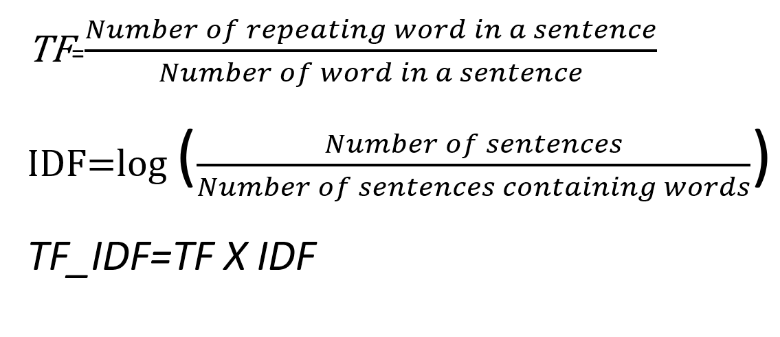
TF_IDF FORMULA

Slide 10
WHY Random Forest Classifier?
Random forest classifier can handle high-dimensional data, which is common in fake news detection.
We find It is robust to noise and can handle noisy or irrelevant features in the data.
It can learn nonlinear decision boundaries between genuine and fake news.
It is an ensemble learning method that combines multiple decision trees, which helps to reduce overfitting and improve generalization.
It can handle imbalanced datasets, which is common in fake news detection.
It is a fast and scalable algorithm that can handle large datasets.
It is easy to interpret and can provide insights into the importance of different features in the data.

Slide 11
Continue why random forest classifier
It takes less training time as compared to other algorithms.
It predicts output with high accuracy, even for the large dataset it runs efficiently.
It can also maintain accuracy when a large proportion of data is missing.

Slide 12
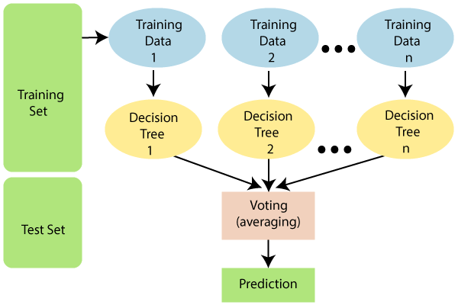
Working of Random Forest Classifier

Slide 13
Algorithm For Random Forest Classifier
Random Forest works in two-phase first is to create the random forest by combining N decision tree, and second is to make predictions for each tree created in the first phase.
The Working process can be explained in the below steps and diagram:
Step-1: Select random K data points from the training set.
Step-2: Build the decision trees associated with the selected data points (Subsets).
Step-3: Choose the number N for decision trees that you want to build.
Step-4: Repeat Step 1 & 2.
Step-5: For new data points, find the predictions of each decision tree, and assign the new data points to the category that wins the majority votes.

Slide 14
Example of Random Forest Classifier
Example: Suppose there is a dataset that contains multiple fruit images. So, this dataset is given to the Random forest classifier. The dataset is divided into subsets and given to each decision tree. During the training phase, each decision tree produces a prediction result, and when a new data point occurs, then based on the majority of results, the Random Forest classifier predicts the final decision. Consider the below image:

Slide 15
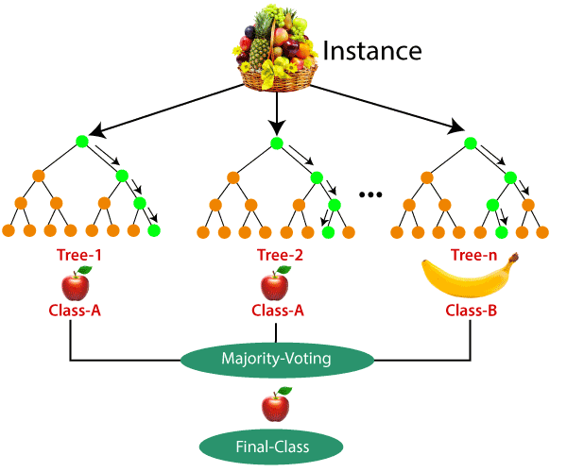
Working of the Random Forest classifier

Slide 16
Expected outcomes
Our goal is to develop a machine learning model that can accurately classify news articles as either genuine or fake with high precision and recall.
This model can be used to identify and flag potentially fake news articles, which can help to prevent the spread of misinformation and improve the overall quality of information on social media and online news sources.

Slide 17
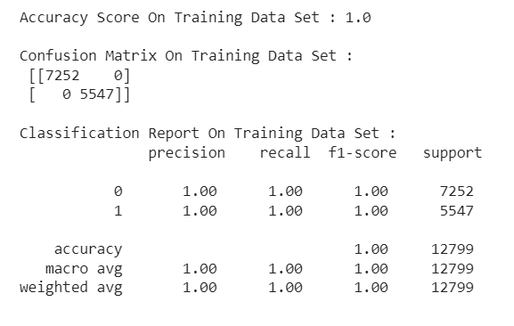
Accuracy score on Training Data_set

Slide 18
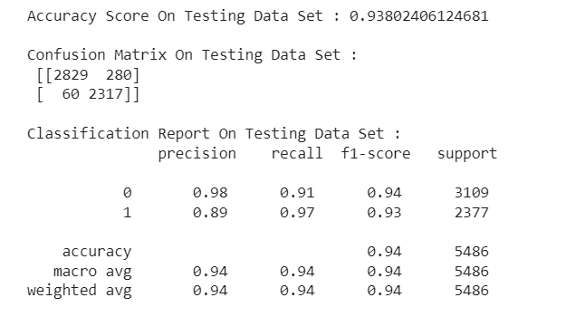
Accuracy score on Testing Data_set

Slide 19
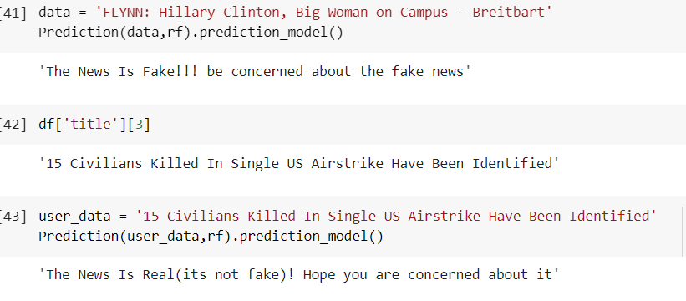
Prediction of Fake or real News

Slide 20
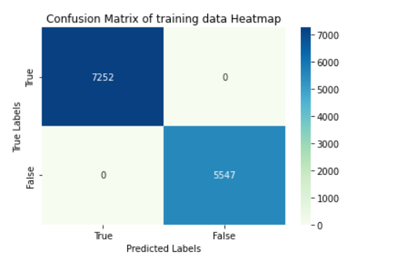
Confusion matrix heatmap of training datasets

Slide 21
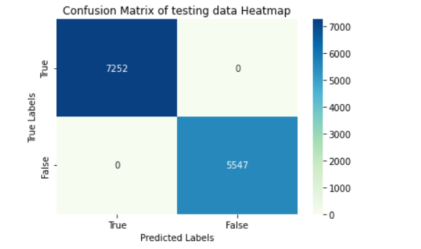
Confusion matrix heatmap of testing datasets

Slide 22
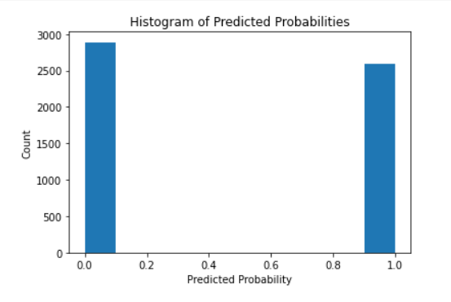
Histogram For Predicted Probabilities

Slide 23
Thank you 🙂🙂

